Slide 1



IMARTICUS LEARNING
PG Diploma Data Analytics and Machine Learning (Batch – PGA27)
Wine Quality Prediction (Capstone Project)
Presented by
Tushar Jaiswal
Rithik Kumar
Sakshi Aggarwal
Naman semwal
Under the guidance of
Vikas Sir

Slide 2
Agenda
Introduction
Problem statement
Objectives
Tools and technologies
Process
Algorithms
Model conclusion
Data dashboard
Important insights

Slide 3
Introduction
Wine quality prediction data is a dataset that contains various chemical properties of different types of wines and their corresponding quality ratings, which range from 3 to 8 where 3 to 6 means (Bad Quality Wine) and 7 to 8 means (Good Quality wine). This dataset is commonly used in machine learning and data analysis applications to train models that can accurately predict the quality of wine based on its chemical composition.
The dataset typically includes features such as acidity, pH, alcohol content, residual sugar, and various other chemical properties that can impact the taste and quality of wine. These features are often measured using scientific methods and instruments, such as spectrometers and chromatographs, to ensure their accuracy.
By analyzing this data, researchers and winemakers can gain insights into the factors that contribute to wine quality and use this information to develop new wines or improve existing ones. Additionally, machine learning models trained on this dataset can be used to predict the quality of wines based on their chemical composition, which can be useful for quality control and other applications in the wine industry.

Slide 4
Problem Statement
The problem statement of wine quality prediction data is to develop a predictive model that can accurately predict the quality of wine based on its chemical properties. This is a supervised learning problem, where the input data consists of the chemical properties of different types of wines, and the output data consists of the corresponding quality ratings.
The goal of this predictive model is to help winemakers and researchers in the wine industry to identify the chemical factors that contribute to high-quality wines and to develop new wines that meet specific quality standards. Additionally, this predictive model can be used for quality control purposes to ensure that the wine produced meets a certain level of quality.
To achieve this goal, machine learning algorithms such as Logistic Regression, Decision Tree,Random Forest,Bagging Classifier and Adaboost can be used to train a predictive model on the wine quality prediction dataset. The trained model can then be used to predict the quality of new wines based on their chemical properties. The accuracy of the model can be evaluated using metrics.

Slide 5
Objective
The objective of wine quality prediction data is to develop a predictive model that can accurately predict the quality of wine based on its chemical properties.
Identify the key chemical properties that contribute to high-quality wine
Train a predictive model using machine learning algorithms: Once the key chemical properties have been identified, machine learning algorithms can be used to train a predictive model that can accurately predict the quality of wine based on these properties.
Use the predictive model for quality control and product development: The trained predictive model can be used by winemakers for quality control purposes to ensure that the wine produced meets a certain level of quality.

Slide 6
Tools And Technologies
MICROSOFT EXCEL
PYTHON PROGRAMMING
PANDAS
NUMPY
SKLEARN
MATPLOTLIB
SEABORN
POWER BI
MICROSOFT POWERPOINT

Slide 7
Process
Conducted Research for collecting data.
Data Processing .
Splitting data into Training and Testing.
Trained the Data by applying different algorithms.
Boosted the Model and made the predictions.
Evaluated the Model
Represented the predictions on visualization tool.

Slide 8
1. Data Research
Feature selection: One important area of research has been identifying the most important chemical properties that impact wine quality. Several studies have used statistical methods such as correlation analysis and to identify the key features that are most strongly correlated with wine quality.
Machine learning algorithms: Various machine learning algorithms have been used to develop predictive models for wine quality, including logistic regression, decision trees, random forests, adaboost and bagging classifier. Researchers have compared the performance of these algorithms and have found that ensemble methods, such as random forests, tend to perform the best.

Slide 9
2. Data Processing
There were no unnecessary columns in the dataset which needs to be dropped.
Applied the label encoder on Quality column which was our target variable to make it categorical
Performed Exploratory Data Analysis (EDA) to see important insights
checked for multicollinearity using heat map.
Made pairplot to see comparison of all columns with target variable
3. Splitting Data
After all the cleaning and processing data has been split into training with 80%, and testing with 20% respectively.

Slide 10
4. Algorithms
Decision tree:
Decision-tree algorithm falls under the category of supervised learning
algorithms.
A decision tree is a flowchart-like structure in which each internal node represents a "test" on an attribute , each branch represents the outcome of the test, and each leaf node represents a class label .
The decision tree from the name itself signifies that it is used for making decisions from the given dataset. The concept behind the decision tree is that it helps to select appropriate features for splitting the tree into subparts.
Training score = 0.9163408913213448
Testing score = 0.909375

Slide 11
Random Forest:
Random forest algorithm falls under the category of supervised learning algorithms.
Random forest builds multiple decision trees and merge their predictions together to get a more accurate and stable prediction rather than relying on individual decision trees.
Random forest, like its name implies, consists of a large number of individual decision trees that operate as an ensemble. Each individual tree in the random forest generates a class prediction and the class with the most votes becomes our model’s prediction.
Training Score = 0.9108678655199375
Testing Score = 0.91875

Slide 12
Logistic Regression:
Logistic Regression is a supervised learning algorithm used for classification.
Logistic regression transforms its output using the logistic or sigmoid function to return a probability value which can then be mapped to two or more discrete classes.
Logistic Regression is a special case of linear regression where the target variable is categorical in nature. It uses a log of odds as the dependent variable. It predicts the probability of occurrence of a binary event utilizing a logit or sigmoid function.
Training Score = 0.874120406567631
Testing Score = 0.89375

Slide 13
Bagging classifier :
Bagging Classifier is a supervised learning algorithm used for classification.
During the training phase, the bagging classifier generates a set of bootstrapped samples by randomly sampling from the original training dataset with replacement.
The advantage of using a bagging classifier is that it reduces overfitting by combining the predictions of multiple base classifiers. It also increases the accuracy and stability of the predictive model by reducing the variance of the model.
Training Score = 0.9116497263487099
Testing Score = 0.90625

Slide 14
5. Model Boosting
Adaboost Classifier:
Adaboost Classifier is a supervised learning algorithm used for classification.
In Adaboost Classifier, trees are just a node with two leaves. They are called stumps. Stumps are weak learners as it will only use one variable to make decisions.
In AdaBoost many different Decision stumps are combined sequentially .
Training Score = 0.9382329945269742
Testing score = 0.928125

Slide 15
Conclusion
Among all the above given classification we get that Random Forest gives us best training score and accuracy. With this we can further use Decision Tree in the Wine Quality Prediction data in future for accurate predictions.
This will help entrepreneurs to :-
Prevent losses.
Save their time and efforts.
Use chemicals that increases the quality of wine.
This will allow them to stay one step ahead of the competition.

Slide 16
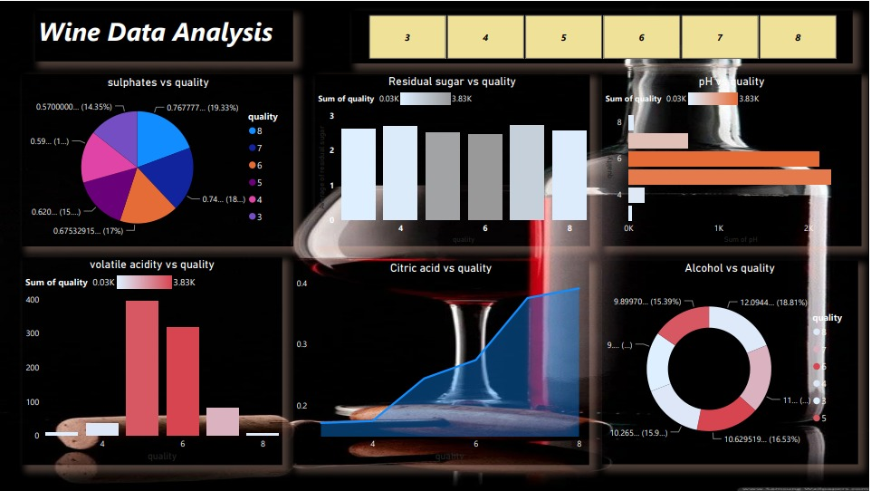
Dashboard View

Slide 17
Important insights:
Through insights we can say that , wine quality prediction data is an important dataset that has been used to develop predictive models for wine quality. Machine learning algorithms and statistical techniques have been used to identify the key chemical properties that contribute to high-quality wines and to develop predictive models that can accurately predict the quality of wine based on these properties.
Random Forest, along with other ensemble methods, has been used to improve the accuracy of predictive models by combining the predictions of multiple base classifiers. Additionally, cross-validation techniques have been used to evaluate the accuracy of the predictive models

Slide 18


